Slide 1

Membership Management System (MMS)
Basic Instructions for Circle Officers
2021-22
Updated March 17, 2022

Slide 2
Table of Contents
What is MMS?
How to Access My MMS Account
  Log In Credentials
  Officer Administration Page
  Edit Your Account
Developing Your Membership Applications
  Application Development Timeframe
  Application Structure
  How Custom Questions Work
  Customize the Application
  Activating/Deactivating Your Application
  Custom Text Fields
  Special Items and Pin Type
  Special or Surprise Initiation
  Publish the Application
Application Review and Approval
Application Review, Approval, and Rejection
Special or Surprise Inductions
Correct the Information on a Certificate Order Form
Membership Payments
Membership Certificate Order
Select What Type of Ceremony
Select the Certificate/Pin Shipping
Revised Amount Owed Section
After the Ceremony
  Returning Certificates/Pins
  Clearing Unhandled Records
  Downloading Past Certificate Orders
  Search for an Individual Member
  Exporting Rosters
Circle Minimum Standards Tracking
MMS Assistance

Slide 3
What is MMS?
Description of the Program
New for 2020-21

Slide 4
What is MMS?
MMS refers to the Membership Management System developed by Omicron Delta Kappa to coordinate the mandatory national membership application, approval, and certificate process.
MMS allows circle advisors, and with some limitations circle presidents, to:
  Tailor the national applications to the needs of the circle
  Accept or reject individuals who have applied for membership
  Review initiation rosters from previous years
  Download reports and spreadsheets of applicants and approved members
  Manage their personal administrative accounts
MMS provides specific initiation reports, but not real-time membership rosters and contact information.

Slide 5
What’s New for FY 2022
  Administration Page Updates - Slide 9
  Application Changes - Slide 20
  Certificate Order Changes - Slide 32
  Circle Minimum Standards (CMS) - Slide 41

Slide 6
How to Access My MMS Account
Log In Credentials, Officer Administration Page, Edit Your Account

Slide 7
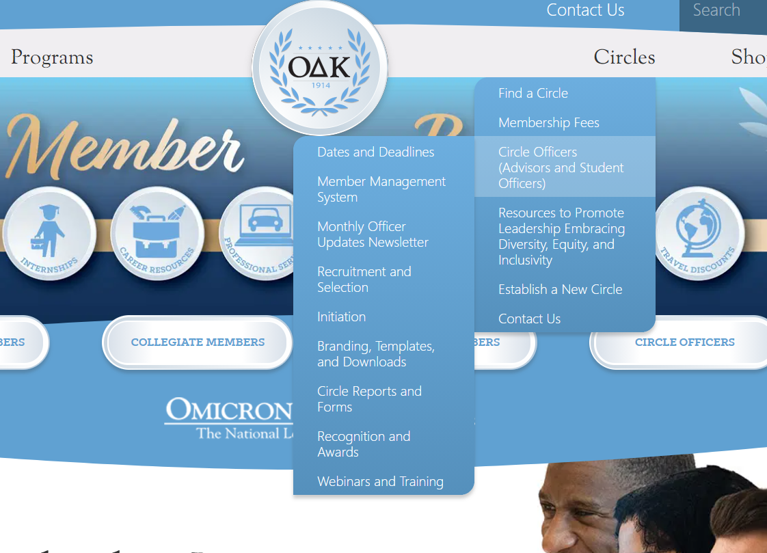
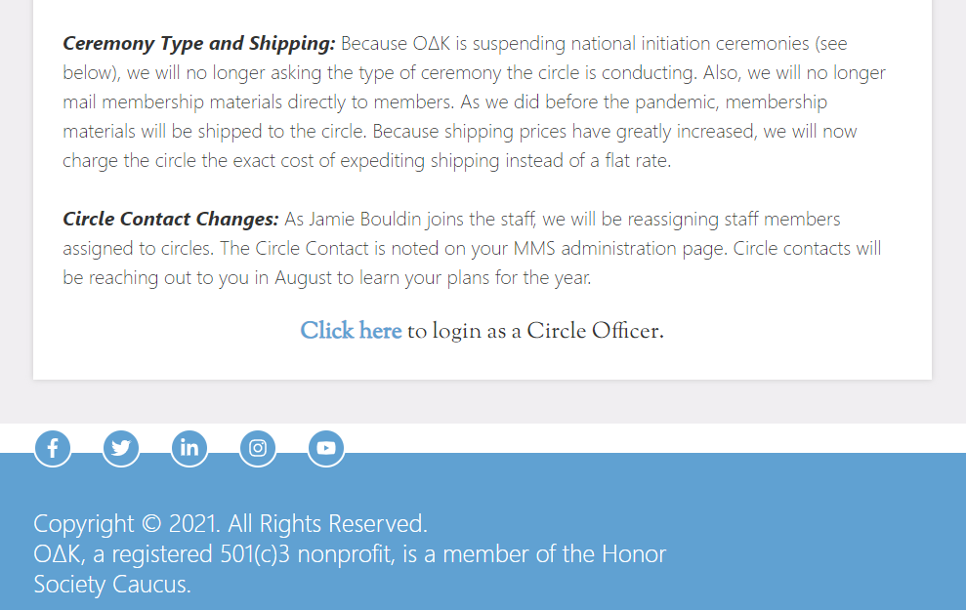
Start at odk.org

Slide 8
Login Credentials
If currently listed as a circle officer, you will automatically have an account created for you. Your email address serves as the login.
On your first time logging in, create a new password by clicking on the link labeled, “Forgot your password?” This will take you to a form that will ask for your email address. After you submit your email address, you will receive an email, to that address, that will include a link to create a new password.
If you have trouble remembering your password or need an account created for you or for student officers, email the Membership Services Coordinator, at odknhdq@odk.org.
You can also login by clicking the “key” at the top of the membership application.

Slide 9
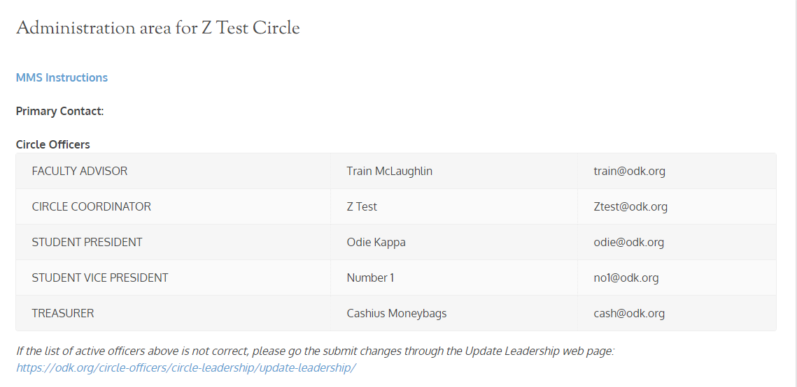
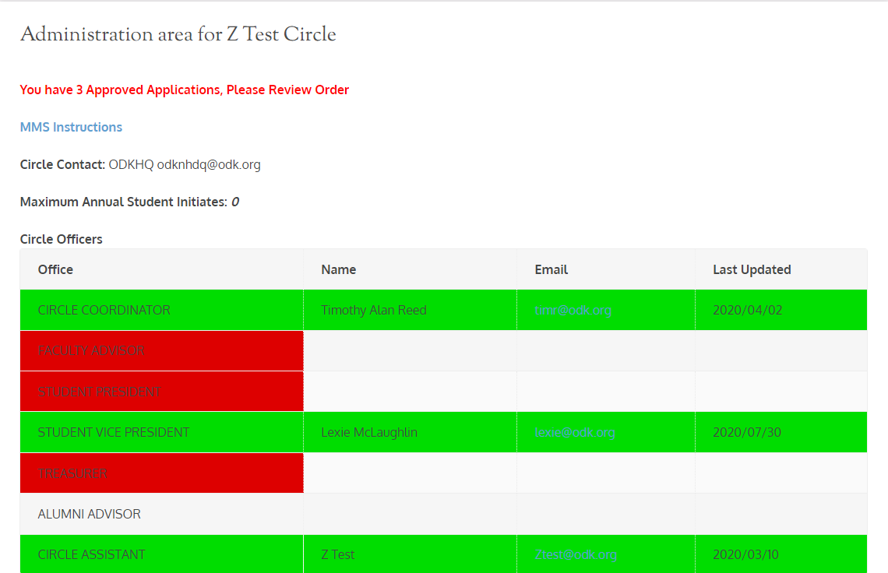
Officer Administration Page
Link to a .pdf of these instructions
The first part of the Administration area provides information about the officers for which OΔK has received Officer Information forms.
Faculty Advisors and Circle Coordinators must have submitted the Circle Advisor Agreement.
Your circle's point of contact at ODK Headquarters
Number of students your circle can initiate each year
List of Authorized Officers (This should have all 5 required officers)

Slide 10
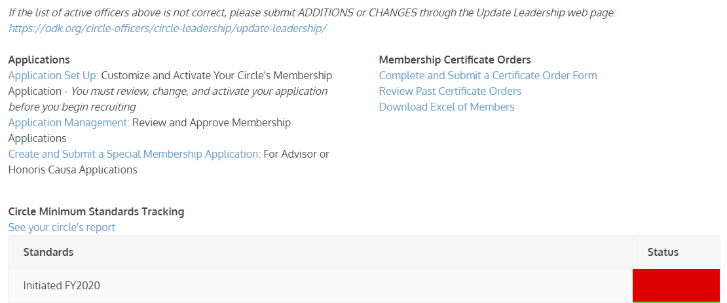
Officer Administration Page
Set Up and Update Your Application
Submit Membership/ Certificate Orders
Review Past Orders
Download Spreadsheet Report of Members
Review and Manage Submitted Applications
Review Circle Minimum Standards met

Slide 11
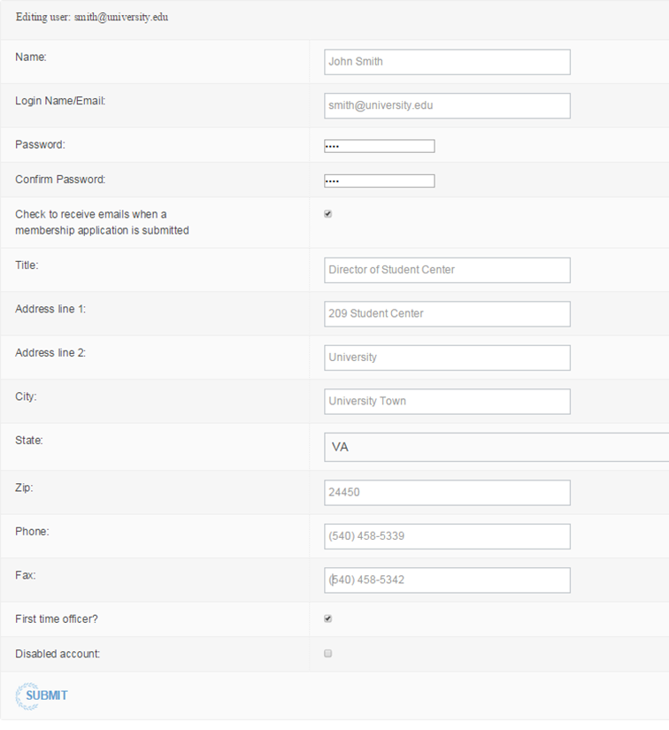
Edit Your Account
To further edit your account, click “Edit Your Account” from your Circle Administration page. You will be taken to a page containing all of your stored information.
You should ensure all information is complete and updated regularly to maintain the most current information. You can also change your password from this page by typing in a new password in both fields that ask for it.
You may also click the checkbox so you are sent an alert by e-mail whenever an individual submits an application for membership at your institution. We recommend you do this during membership recruitment time unless you check your applications page regularly.
NOTE: Only O∆K-HQ Staff should create new accounts. DO NOT OVERWRITE previous information for new officers. Each new officer should receive his or her unique ID and password.

Slide 12
Developing Your
Membership Application
Circles can add special questions and fields to the national application

Slide 13
Application Development Process
REVIEW
REVISE
TEST
PUBLISH
Check over the previous application for any changes, spelling corrections, or updates in information that will improve your application.
Revisions should always occur BEFORE you start accepting applications for a cycle. All applicants should receive the same application version.​
Have officers complete a “test application” to ensure all fields report in the manner intended.
Remember to delete test applications.​
All application changes are live when the “submit” button is selected. Make sure
everything is set before you activate your application.​
Check this box to turn on and turn off your circle's application acceptance.

Slide 14
Application Structure
The National Leadership Honor Society Membership Form (Application) has two types of items:
Required (by the Society) and custom (inserted by the circle).​
Required items include the basic membership information (name, email, address, etc.) that is required and cannot be changed. The default application has the required items. If the circle does not change any fields, this is the application your prospective members will see.
Custom items are those that the circle chooses to select and add to the application. Only the items selected and approved by the circle will appear on the application seen by individuals on your campus. Circles are limited to the options shown and cannot create items specific to their campus.

Slide 15
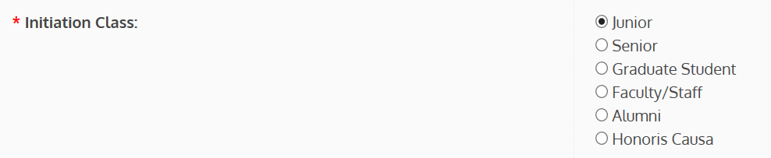
How Custom Questions Work
The new application is dynamic using Branching logic. It changes based on the first two (2) choices made by the applicant.
When first opened in a web browser, ALL applicants see the same application.
The first change occurs when they select College/University. This narrows their choices to only that circle. (If your school does not appear, the “RECEIVE Applications” box is not checked.)
The second change occurs when they choose Initiation Class. Juniors and Seniors may see a different application depending on the selection made in the Special Request Fields.
The application a prospective member sees will be determined by the “Class” they select. For example, if an applicant selects “Junior,” s/he will receive the application with academic data and custom questions. If the applicant chooses "Faculty/Staff," s/he will receive an application that has only the fields the circle requires for them.

Slide 16
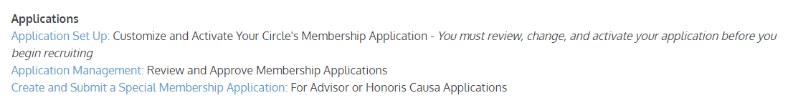
Customize the Application
To edit your custom fields, select “Application Set Up: Customize and Activate Your Circle’s Membership Application”
Start Here

Slide 17
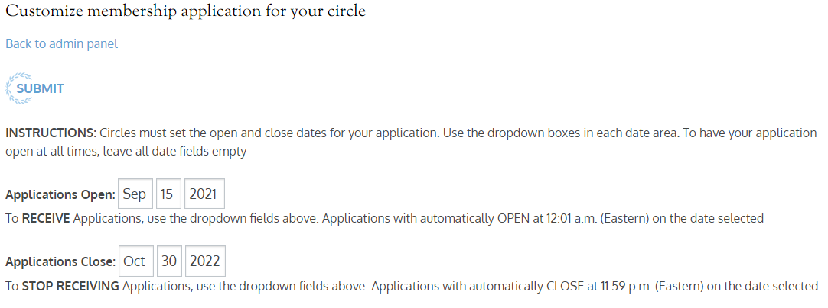
Activating/Deactivating
Your Application
Beginning in September 2021, OΔK moved to a date only process for activating the applicationThis can be reset for each recruitment period.

Slide 18
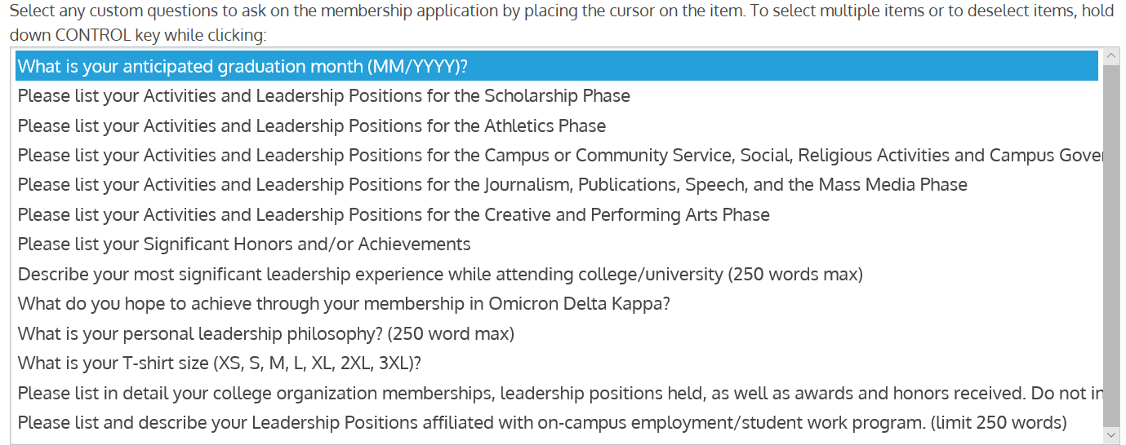
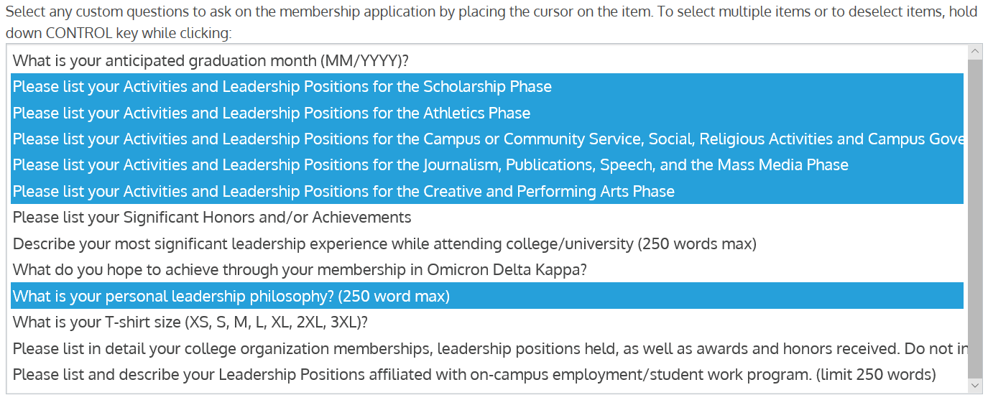

Custom Text Fields
Highlighted areas represent fields selected by the circle to appear on the application. When your circle reactivates its application, be sure to check your custom questions to ensure they are still what you want for the new fiscal year.
Before Selection
After Selection
Don’t forget to click Submit!

Slide 19
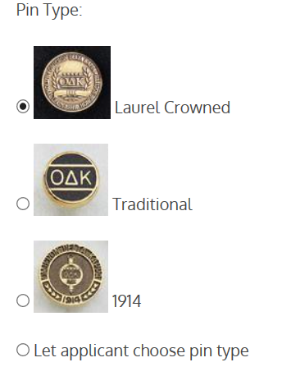
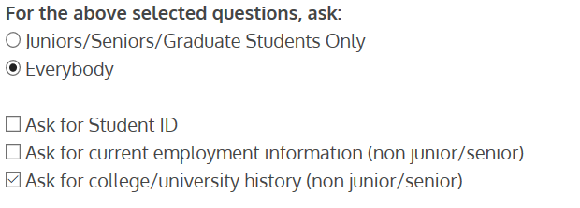
Special Items & Pin Type
Special Request Fields
Pin Type
You can limit the items non-students view and control specific items like Student ID, employment and university history for non students.
The Board of Trustees recently approved a new pin for Omicron Delta Kappa initiates. To have a single and lasting symbol of membership for all initiates, the new "Key of Membership" will be the only pin issued for ceremonies. The choice of the pin has been removed from the application.
Demographic Items
Five new demographic items have been added to the application to aid our efforts in understanding the diversity and inclusivity of our membership. The data will be redacted from the application view available to circles and will not appear in circle spreadsheet downloads. Only the National Headquarters will have access to the data.

Slide 20
Special or Surprise Initiation
Many circles want to surprise a faculty member, alumnus, or honoris causa member with initiation into ΟΔΚ. That is perfectly fine to do. Please note the following:
Anyone using the circle’s customized form will receive notification that an application has been received.
If you do not want your “surprise inductee” to be notified, you can complete the application for that individual.
This is the ONLY time you can complete an application for the individual.
This should not be used for student inductees.
This form should be used for NEW Circle Advisors.
  To complete the special or surprise application:
  Go to the Administration Area on MMS.
  Select “Create and Submit a Special Membership Application.”
  Complete the form with all information and submit.
  Because the advisor is completing the form, the advisor will receive confirmation from the system that application has been received.

Slide 21
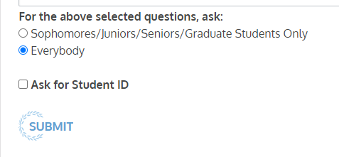
Publish the Application
Once you have customized all fields, select Submit. The changes will occur immediately.
To review the new application, Return to the login/application (membership.odk.org)
Remember, you must select a circle AND a class for to review the application for your circle. (see slide 12)

Slide 22
Application Review and Approval
Three Steps to Application Processing

Slide 23
Application Review and Approval
There are 4 steps in the Application Review and Approval Process:
  Step 1 - Review Applications
  Step 2 - Accept/Reject Applications
  Step 3 - Verify Payment and Approve for Membership
  Step 4 – Submit the Certificate Order
For on-campus or in-person initiation ceremonies: All of these steps should be completed no less than 14 calendar days prior to your initiation ceremony. This ensures that ΟΔΚ can process your order, print certificates, and ship them to you in time. Many times this takes less than 14 days.
Only faculty advisors and circle coordinators are permitted to access applications. Applications can be printed for officers or committee to review.
Advisors can download a spreadsheet of application information to provide to officers or committee as well.
IMPORTANT NOTICE: Circle advisors or other members of the circle are not permitted to complete an application for the initiate. This includes FACULTY/STAFF and ALUMNI because the application constitutes a contract and includes permissions that must be accepted by the member. A third party may no longer complete the application for the initiate. Honoris Causa and Special Inductions can be completed by a third party but MUST include all required information accurately submitted.

Slide 24
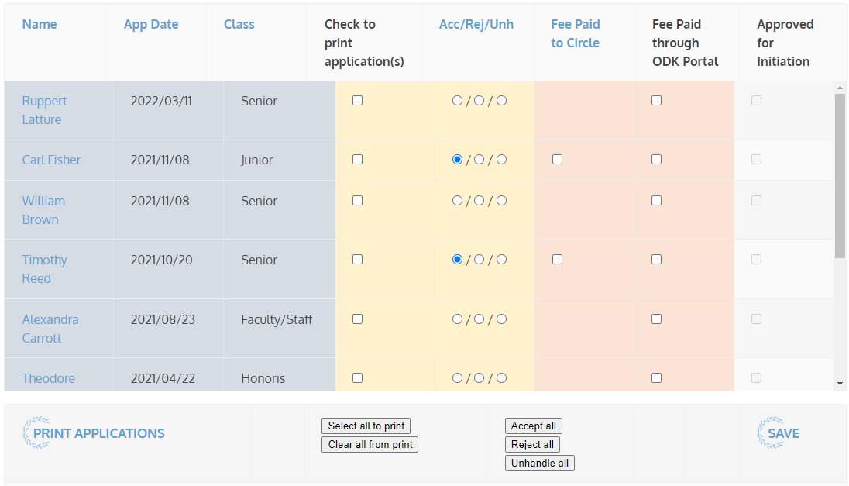
Step 1: Application Review
The Membership Application form is designed to be processed online.
When an application is submitted it will be made available for review by the circle advisors at the circle where the member is applying. Email notification is not given unless you specifically request for this to be turned on in your profile.
To review submitted applications:
  Go to MMS and login.
  Go to Circle Admin Page. Click on the “Application Management”
  On this page you will notice the bold “Unhandled (UNH).” This means that the application has not been approved or rejected.
  Select the name to view the submitted application.

Slide 25
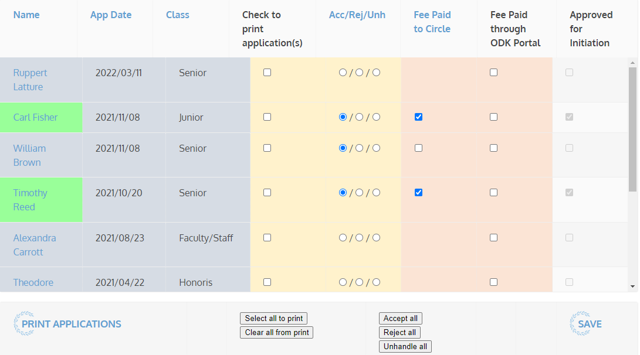
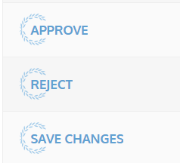
Step 2: Accept or Reject
Each circle has its own process by which they review and vote on candidates for membership. Circles may choose to print applications to PDF and post them for review, or print hard copies.
a. Select applications to print
b. Select print applications
Once all applications have been reviewed and the circle has voted, return to the Application or to the Applications panel to Accept or Reject each application.
Rejected applications will be stored on a page called Rejected Applications, while the approved applications will appear with the bold term “Accepted.”

Slide 26
Correcting the Information on a
Membership Application
If you find a problem with information provided on a Membership Application, you can change the information BEFORE you submit the final order.
Open the Membership Order Form
Select the Membership Summary
Select and Open the Member Application
Change the information (e.g. correct the name spelling)
Scroll to Bottom, Accept or Reject
Select Save Changes
Return to the Application Management page. Check to ensure the payment box is checked.
Complete the Certificate Order information again.
Double Check the Certificate Order to ensure Name has been added or removed from the order.
FINAL STEP: Notify ODK HQ that you have made any alterations IMMEDIATELY. If you need to reject or accept a candidate AFTER you have submitted the final order, you must do this BEFORE the order is processed at the National Headquarters.
(We do not recommend this but it may be necessary if a student pays late or decides to drop out BEFORE we process the order.)

Slide 27
Step 3: Membership Payment
The circle is responsible to make sure each new member pays the national lifetime membership fee. There are two options:
Circle Pays from Invoice: Each circle has the option to collect the fees from the initiate and remit a single check or credit card payment to the national headquarters.
Initiates Pay via web form: Initiates can also pay online (http://odk.org/national-membership-enrollment-and-payment/) but the circle is responsible for verifying that each new member has paid before the initiation date.
  We now have the ability to turn the payment system on and off for each circle.
  Circles using the online payment system must notify the National Headquarters (odknhdq@odk.org) in advance.
  All payment systems will be set to off until ΟΔΚ HQ is instructed to start accepting payments. As soon as the certificate order is submitted, the payment portal will be turned off.

Slide 28
Step 3: Membership Fee Verification and Final Approval
Each column can be sorted by clicking on the column header in blue.
Paid Fee to Circle: If the circle is accepting the Lifetime National Membership Fee, the advisor must mark the bubble in that column when payment is received.
Paid Fee Online: If the payment is through the online form, ODK Staff will mark the bubble in that column. Advisors cannot mark bubbles in this column.
When an application has been Accepted and marked Paid, the Name box will change to green to indicate the individual is Approved for membership and check will appear in the Approved for Initiation column
Applicants will ONLY appear on the Membership Order if Accepted and Marked Paid

Slide 29

Step 4: Membership Certificate Order
Once your circle accepts applications, the Faculty Advisor or Circle Coordinator must submit a Membership Certificate Order Form to complete the membership process. From the Administrative Panel, go to Certificate Orders. Select "Complete and Submit a Certificate Order Form”
The membership certificate order form will automatically include the names of accepted applicants. Please verify the individuals, spelling of names, and the total number, fill in all the remaining information including shipping address, and submit the membership certificate order form.
You MUST click SUBMIT for your order to be processed. The order will appear immediately in “Review Past Certificate Orders.” If it does not, contact the National Headquarters (odknhdq@odk.org)

Slide 30
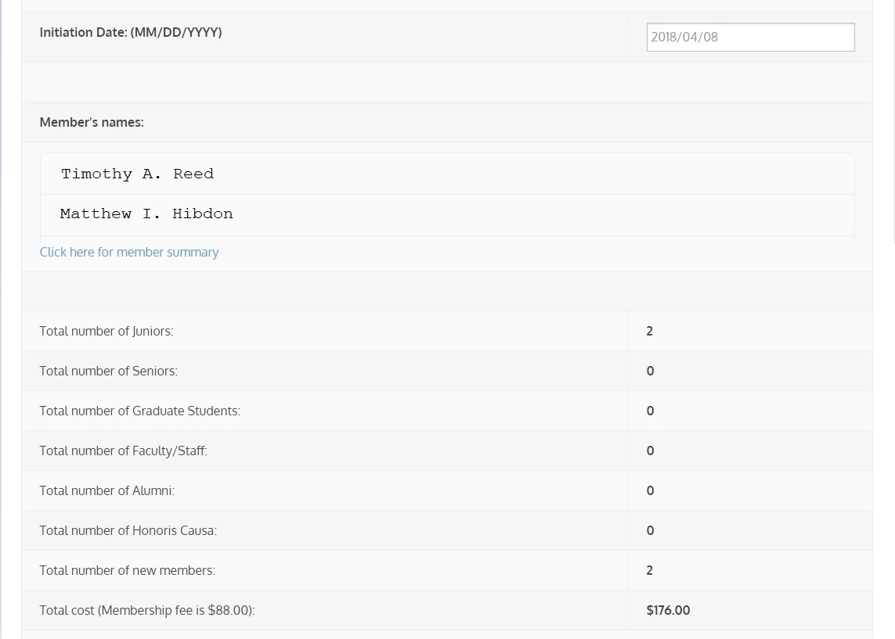
Example of the
Certificate Order Form
Important things to look for:
Make sure all the names are spelled correctly and are appropriate. ΟΔΚ does not permit nicknames like “Scooter” on the certificate.
Are the numbers correct? Did you miss approving someone?
Is the Initiation Date correct? (In January, we get many “the year before” dates!)

Slide 31
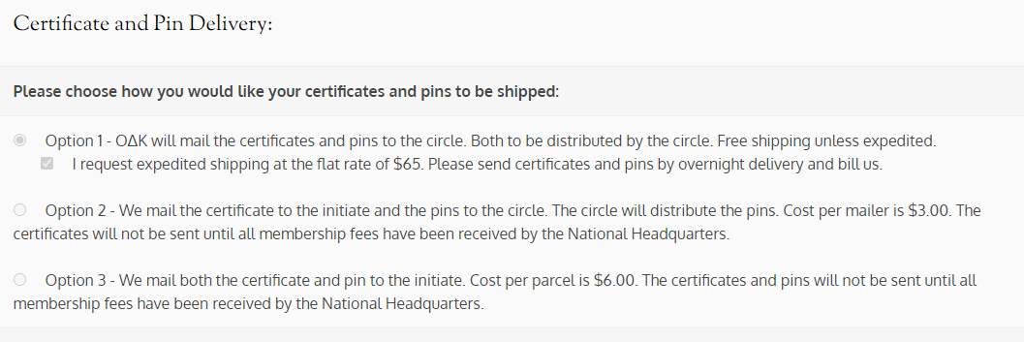
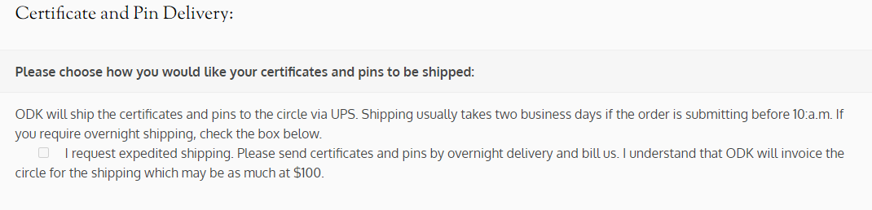
Select the Certificate/Pin Shipping
Membership Pins: The Board of Trustees approved a new pin for Omicron Delta Kappa initiates. To have a single and lasting symbol of membership for all initiates, the new "Key of Membership" will be the only pin issued for ceremonies. The choice of the pin has been removed from the application.
Ceremony Type: Because OΔK is suspending national initiation ceremonies, we will no longer be asking the type of ceremony the circle is conducting. Circles are encouraged to hold in-person ceremonies where permitted. Online ceremonies are still permitted.
Shipping: As we did before the pandemic, membership materials will be shipped to the circle. We will not ship directly to new initiates. Normal shipping is still free to the circle. For expedited shipping, we will charge the circle the exact cost instead of a flat rate because shipping prices have greatly increased.

Slide 32
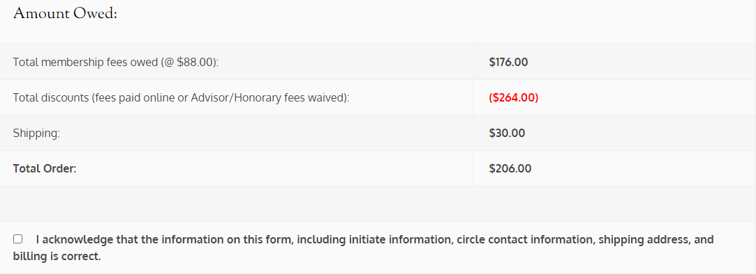
Revised Amount Owed Section
To fully demonstrate what the circle will owe upon submission of the order, this section has been revised. The order below shows what an order would look like with expedited shipping.
The circle owes ODK for 2 members who paid the circle
Credit for 1 member who paid online, 1 free advisor, 1 free honorary
Cost for expedited shipping is usually ($70 - $100)
Total owed to ODK, which will be invoiced.

Slide 33
After the Ceremony
The Initiation process is not complete until you make sure all records are handled.

Slide 34
Returning Certificates/Pins
The official policy of Omicron Delta Kappa is that there are no refunds once certificates have been printed.
We will refund membership fees provided the certificate and pin are returned to the ΟΔΚ Headquarters no less than 30 days after the initiation ceremony. After 30 days, ΟΔΚ has the right to refuse to refund the fees.
If the certificate and pin are returned, an $8.00 processing fee will be withheld from the credit (Total $80 credit)
If the pin is not returned, an additional $15.00 will be withheld from the credit (Total $65 credit)
If no certificates or pins are returned, the circle will be held accountable for all membership fees approved as part of the membership order. Please note that because the individual was not fully initiated, he/she will still not be considered a member of ΟΔΚ even if the fees were not refunded.

Slide 35
Clearing Unhandled Records
Once a ceremony has been held, all fees are fully paid, and the initiation process is closed, the circle advisor should log in to MMS and process “unhandled” applications.
All unhandled applications should be marked “rejected.”
Once this process is complete, the application queue should be empty and ready for the next round of applications.
ΟΔΚ national headquarters will audit all circle records on an annual basis and reject any application that has been left “unhandled” for more than 12 consecutive months.

Slide 36

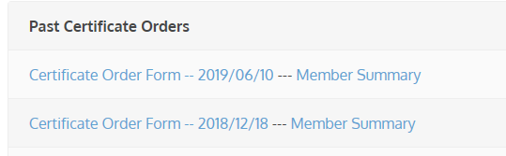
Downloading Past Certificate Orders
Advisors can download past certificate orders in an Excel or CSV file of applications, initiated or rejected members, and unhandled records.
  Select Certificate Orders
  Select Certificate Order Form you want, open and print.

Slide 37
General Membership Record Management
Review, Manage, and Download Membership Lists and Individual Records.

Slide 38
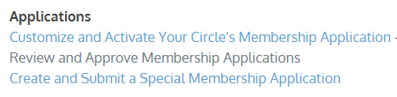
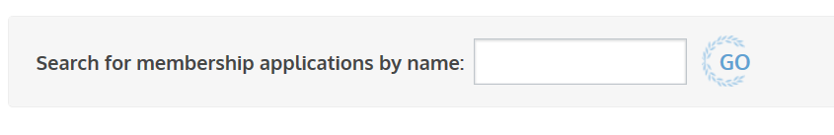
Search for an Individual Member
Advisors can now search all MMS records for an individual using the search function under the Membership Applications link.
  Select "Review and Approved Membership Applications"
  Type the name you want to find and select Go.

Slide 39
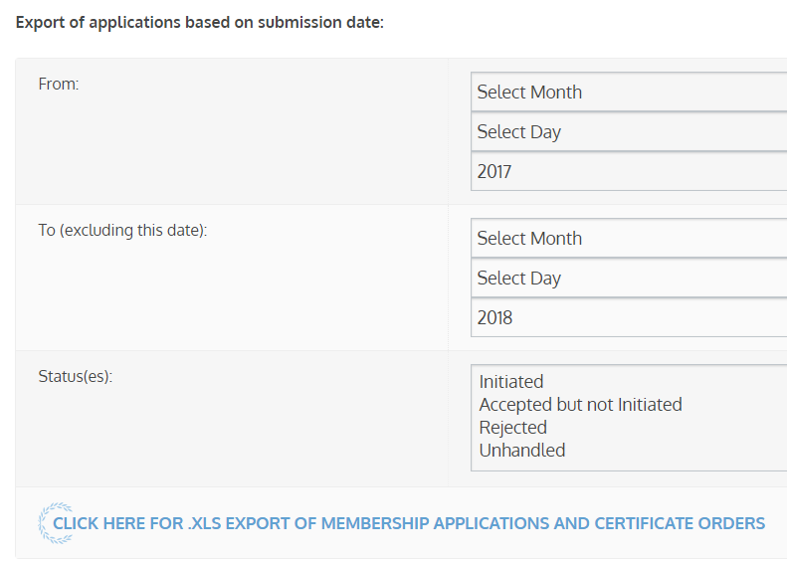
Exporting Rosters
Advisors can download an Excel file of applications, initiated or rejected members, and unhandled records.
  Go to Account Management
  Select “Download Excel of Members”
  Enter dates
  Select Status
  Click to Download

Slide 40
Circle Minimum Standards Tracking
Know what your circle has completed and needs to complete

Slide 41
Minimum Standards
The O∆K Minimum Standards synthesize the various bylaws and policies that require specific action by the circles into one list. These minimum standards will be the basis by which the national organization considers a circle “in good standing.”
Only circles in good standing will be eligible for Clay Grants, Gift of Membership, and Circle Recognition Awards. Print a copy of the O∆K Minimum Standards for your records.
Circle Minimum Standards Tracking is reset on September 1 each year.
  The circle advisor and voting F/S member columns will be reset when we learn of a vacancy in these positions.
  The student officer columns will be reset if we have not received an update for more than 1 calendar year from the last update.

Slide 42
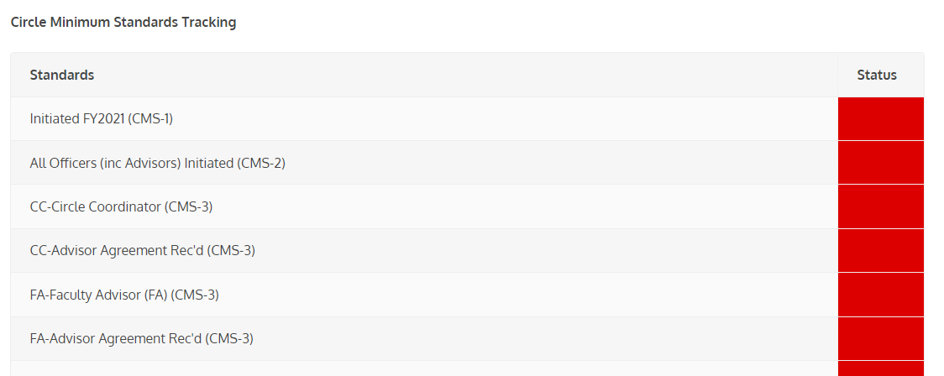
Tracking
To assist Circles in tracking which of the minimum standards they have met for each year, ΟΔΚ has placed a tracking system in the MMS.
Each time a circle meets one of the criteria, a staff member at ΟΔΚ National Headquarters tags that in the MMS system, which is then displayed on the circle’s administrative panel. ​
Red = Incomplete ​
Green = Complete
The "CMS-#" refers to the specific Circle Minimum Standard
These boxes change to green when the standard is met

Slide 43
MMS Assistance
If you ever need assistance with MMS, do not hesitate to call the ΟΔΚ national headquarters (540-458-5336). Our office hours are 8:30 am – 5:30 pm Eastern, Monday through Friday. You can also email us at odknhdq@odk.org
Some final reminders:
  Certificate request submission should be placed NO LESS than 14 calendar days BEFORE your CEREMONY.
  ALL initiates must have PAID BEFORE we will issue certificates and pins. For circles paying by check, this means an invoice has been issued. For those paying online, we will only process those paid.
  Do not count on weekend deliveries for certificate orders.
  We will not process refunds after 30 days post-ceremony.

